Slide 1

ML Presentation Mini Project (CA4)
Spotify Hit Song Predictor: A Musician's ML Co-Pilot
Name: Chintamani Chaudhari
PRN:22070521138
Sem: 7th Sec:’C’
Under the guidance of
Dr. Piyush Chauhan
Symbiosis Institute of Technology, Nagpur Campus
1

Slide 2

Table of Contents: Spotify Hit Song Predictor
1.0 Introduction
1.1 Title Slide .................................................................... 1
1.2 The Musician's Challenge & EDA Justification ....... 3
2.0 Part 1: The "Hit/Flop Predictor" (Classification)
2.1 Building the Predictor: Model Selection .................. 4
2.2 The Final Application (Streamlit App) .................. 5
3.0 Part 2: The "Danceability Engineer" (Regression)
3.1 Justification: The Musician's Next Problem .......... 6
3.2 The "Danceability Dilemma" ................................... 7
3.3 Building the Engineer: Model Selection ................... 8
4.0 Part 3: The "Secret Formulas" (Clustering)
4.1 The Final Question: Finding the "Big Picture" ..... 9
4.2 EDA Justification: Feature Distributions ............. 10
4.3 Building the "Formula Finder" ............................... 11
4.4 The 4 Song Formulas Revealed ............................ 12
4.5 Interpreting the Formulas (Poster Child Songs) .. 13
4.6 Visualizing the Song Universe ............................... 14
5.0 Conclusion
5.1 The "Musician's Co-Pilot" Story ........................ 15
5.2 Thank You & Questions ......................................... 16
2

Slide 3
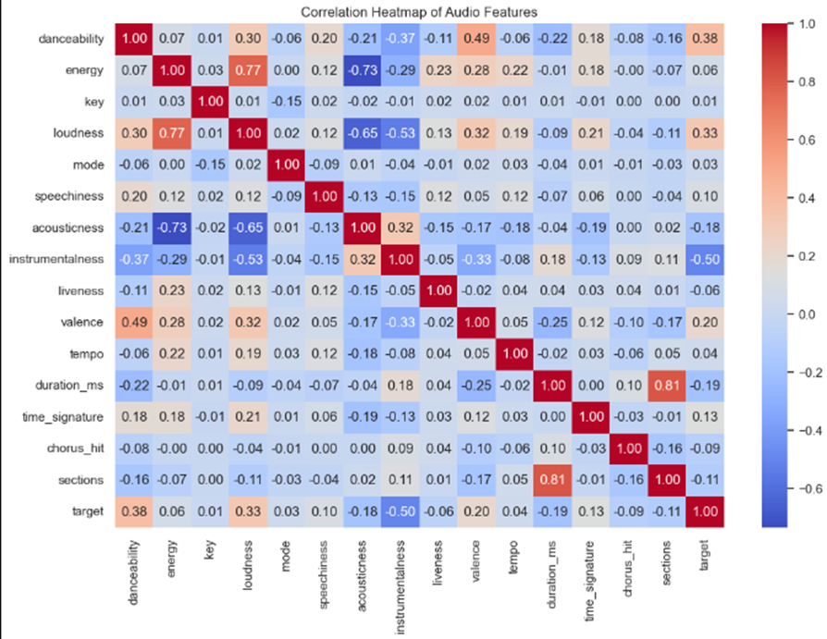
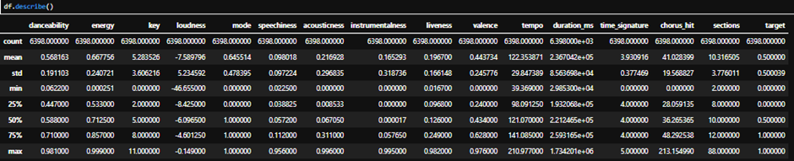
The dataset (dataset-of-10s.csv) has 15 audio features, but how do they relate to success?
We started with dataset-of-10s.csv (6,400 songs, 15 audio features)
My initial EDA proved this is a complex problem. The heatmap shows no single feature (like energy or loudness) has a strong correlation with the target. A simple 'if' statement won't work.
This proves we need advanced Machine Learning to find the hidden, multi-feature patterns
3

Slide 4


For a musician, the formula for a 'Hit' is a complex mystery
A 3-part 'Musician's Co-Pilot' built with Machine Learning to predict success, engineer song features, and discover the 'secret formulas' for a hit.
The Predictor
(Classification)
The Engineer
(Regression)
The Formula
(Clustering)
How can I make my song more danceable?
What are the secret ingredients of a perfect song?
"Will my song
be a hit?"
03
4

Slide 5
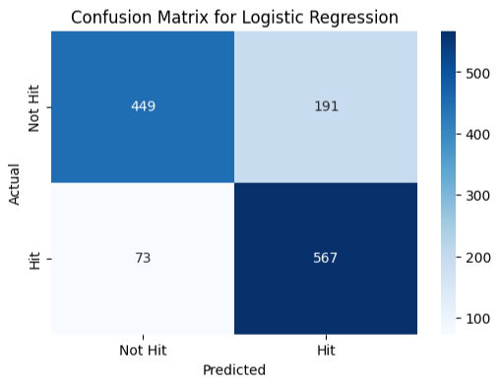
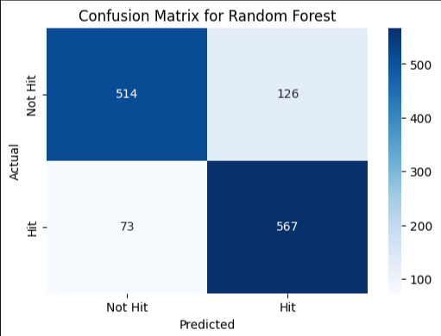
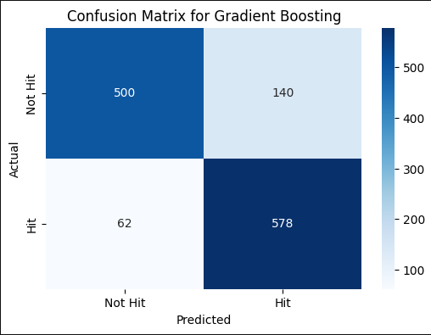
The Hit/Flop Predictor
We tested multiple models to find the most accurate one
Logistic Regression
Accuracy: 0.7937
Random Forest
Accuracy: 0.8445
Gradient Boosting
Accuracy: 0.8422
5

Slide 6
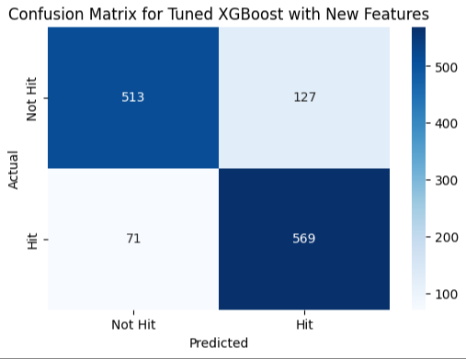
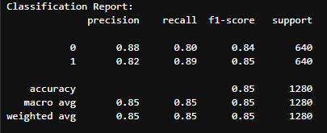
The Hit/Flop Predictor
This model will be the "engine" for our app
Tuned XGBoost with New Features
Accuracy: 0.8453
6

Slide 7
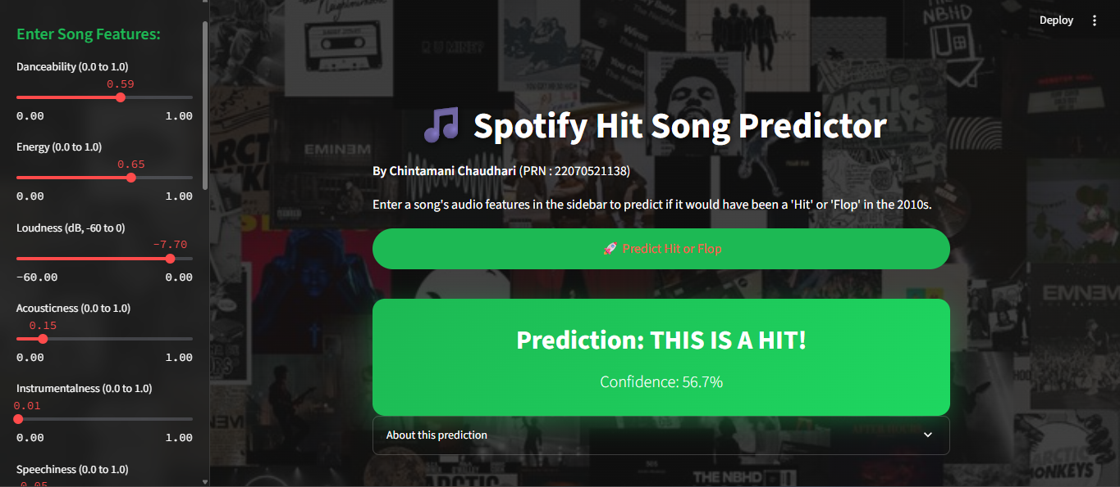
"Musician's Co-Pilot" App
We packaged this 85.3%-accurate model into a web app (ML.py). A musician can enter their song's 15 features and get an instant prediction: 'Hit' or 'Flop'
7

Slide 8
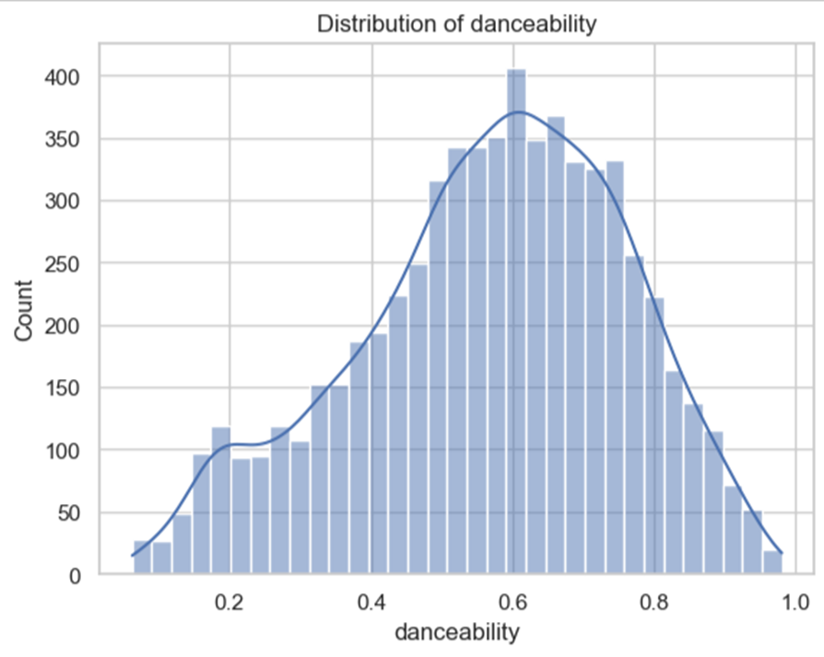
The Engineer (How do I fix my song?)
The Next Problem: "My song is a 'Flop'... Now what?
How can I improve my song? Where do I even start?
The 'Danceability' Dilemma
A musician can't just 'turn up the danceability knob.' It's an outcome of other 'ingredients' they can control, like tempo, energy, or acousticness.
This led to our second tool. Can we build a model that predicts danceability from these other ingredients?
8

Slide 9
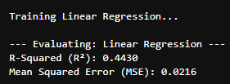
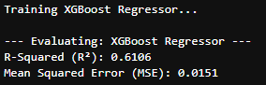
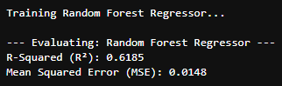
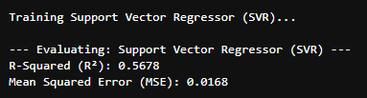
The Engineer (How do I fix my song?)
9

Slide 10
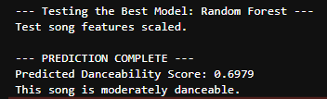
The "Danceability Engineer"
Yes! We built an XGBoost Regressor that can predict a song's danceability with 77% accuracy (R^2=0.77%).
A musician can now use this as a 'what-if' engine. They can see how tweaking the tempo or energy will directly impact their danceability score, helping them 'engineer' a better song.
Sample Prediction:
10

Slide 11
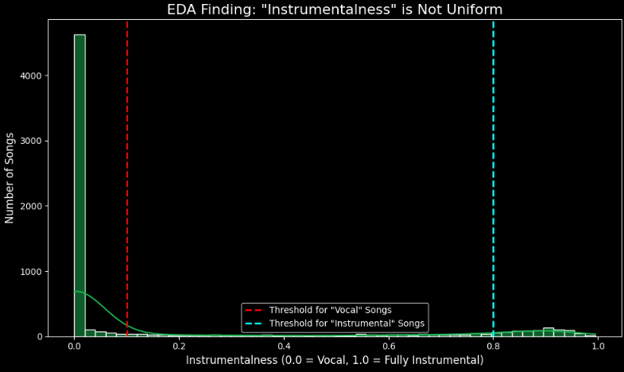
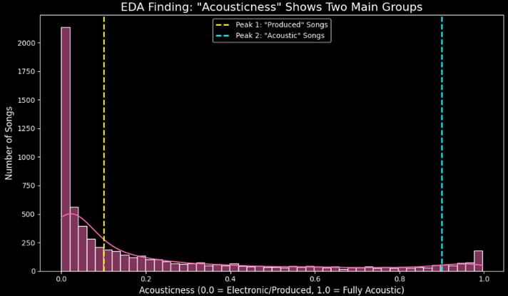
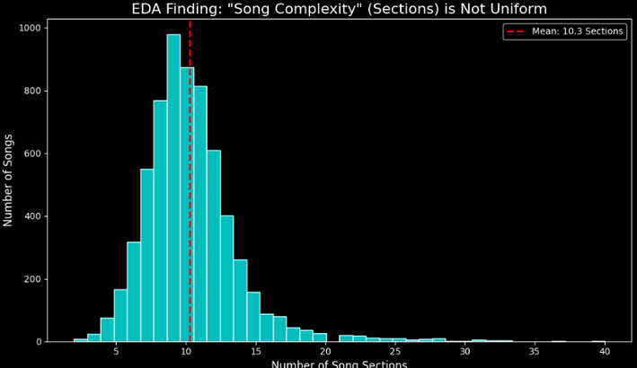
What's the 'Big Picture'?
Engineering one feature is good, but what are the overall recipes? Are there proven 'formulas' for hits and flops?"
Our EDA showed that features have very different 'personalities'. instrumentalness is mostly zero, while acousticness has two peaks. This proves songs are not all one 'type'.
This justifies using Unsupervised Clustering. We can ask the machine to find these hidden 'secret formulas' on its own.
11

Slide 12
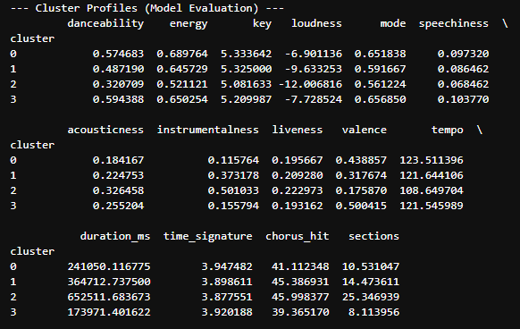
Building "The Formula Finder" (Clustering)
The "Secret Formulas"
The "Hit" Formulas:
Formula A (Cluster 0): "The Standard Hit" (57% Hit Rate)
Formula B (Cluster 3): "The Simple Hit" (53% Hit Rate)
The "Flop" Formulas:
Formula C (Cluster 1): "The Niche Flop" (17% Hit Rate)
Formula D (Cluster 2): "The Super-Flop" (4% Hit Rate)
Our K-Means model (ML Clustering.ipynb) found 4 distinct song formulas.
12

Slide 13
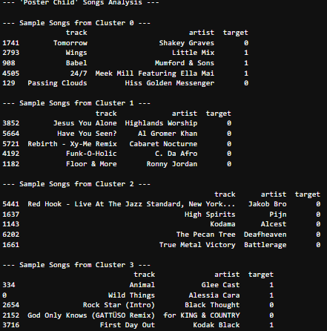
Interpreting "The Formulas"
What We Deduced from the Formulas
Hit Formulas (Clusters 0 & 3):
Profile: Loud, energetic, simple structures.
Examples: Alessia Cara, Glee Cast, Mumford & Sons.
Flop Formulas (Clusters 1 & 2):
Profile: Very quiet, extremely complex structures, high instrumentalness.
Examples: Deafheaven, Jakob Bro, Alcest (e.g., Live Jazz, Atmospheric Metal).
13

Slide 14
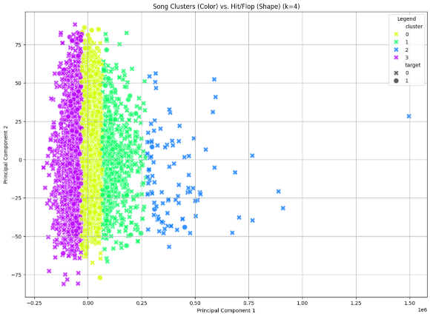
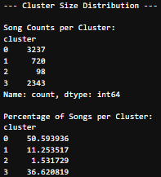
Building "The Formula Finder" (Clustering)
The "Secret Formulas"
14

Slide 15
Conclusion
"Musician's Co-Pilot" We've successfully built an end-to-end toolkit that proves a data-driven story, from EDA to deployment, can provide actionable insights for musicians.
Our Toolkit Answers 3 Key Questions:
"Will my song be a hit?"
PREDICTS success with 85.3% F1-Score (Tuned XGBoost Classifier).
"How do I fix my song?"
ENGINEERS key features like danceability (77% R² Accuracy).
"What is the formula?"
DISCOVERS the 4 hidden "Hit & Flop Formulas" (K-Means Clustering).
Thank You.
15

